Slide 2


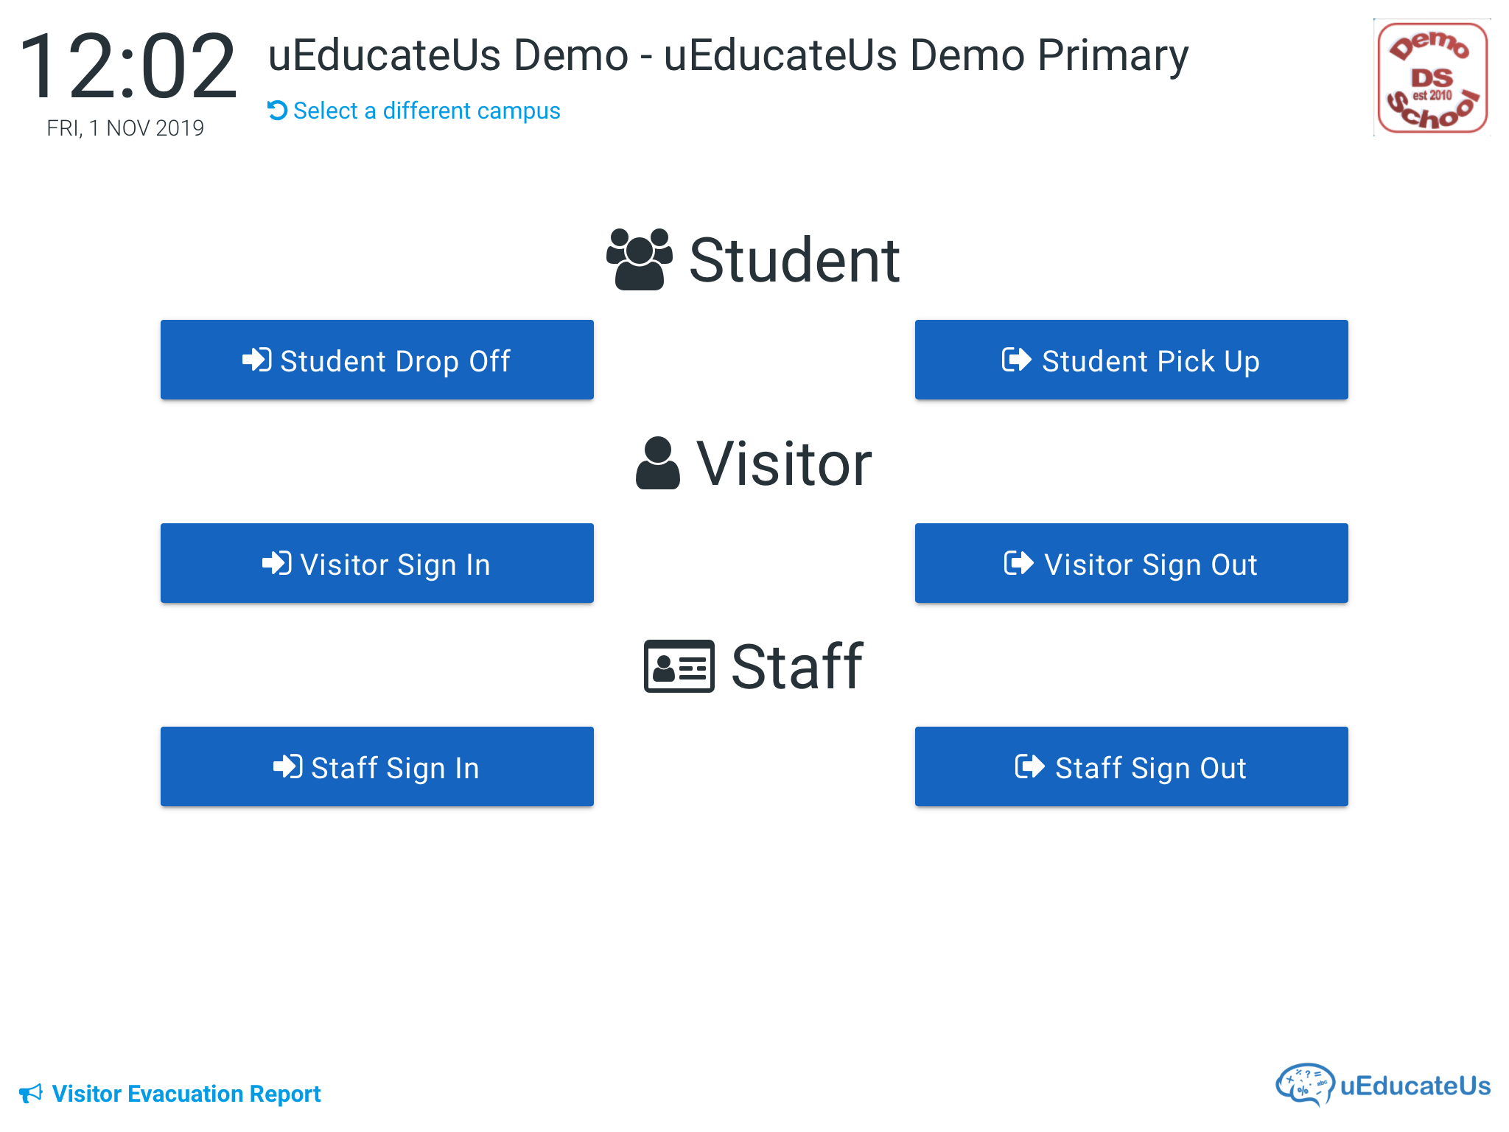

Kiosk
Troubleshooting Guide.
iPad introduction
iPad features you need to know.
Open Apps view
No internet connection
Checking your iPad has a internet connection
Restarting the Kiosk App.
Reboot iPad
Deleting and installing the Kiosk App
Contact uEducateUs Support.
Replay
Prev
Home
Next
uEducateUs – powered By Linked Success

Slide 4
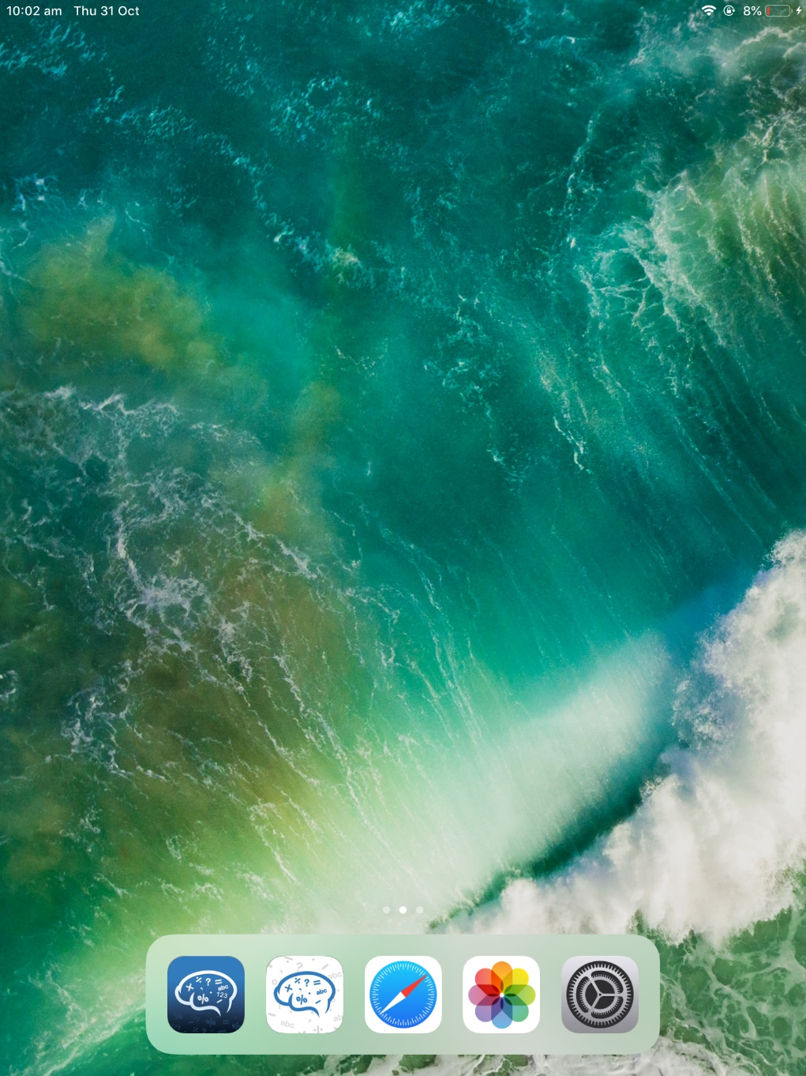
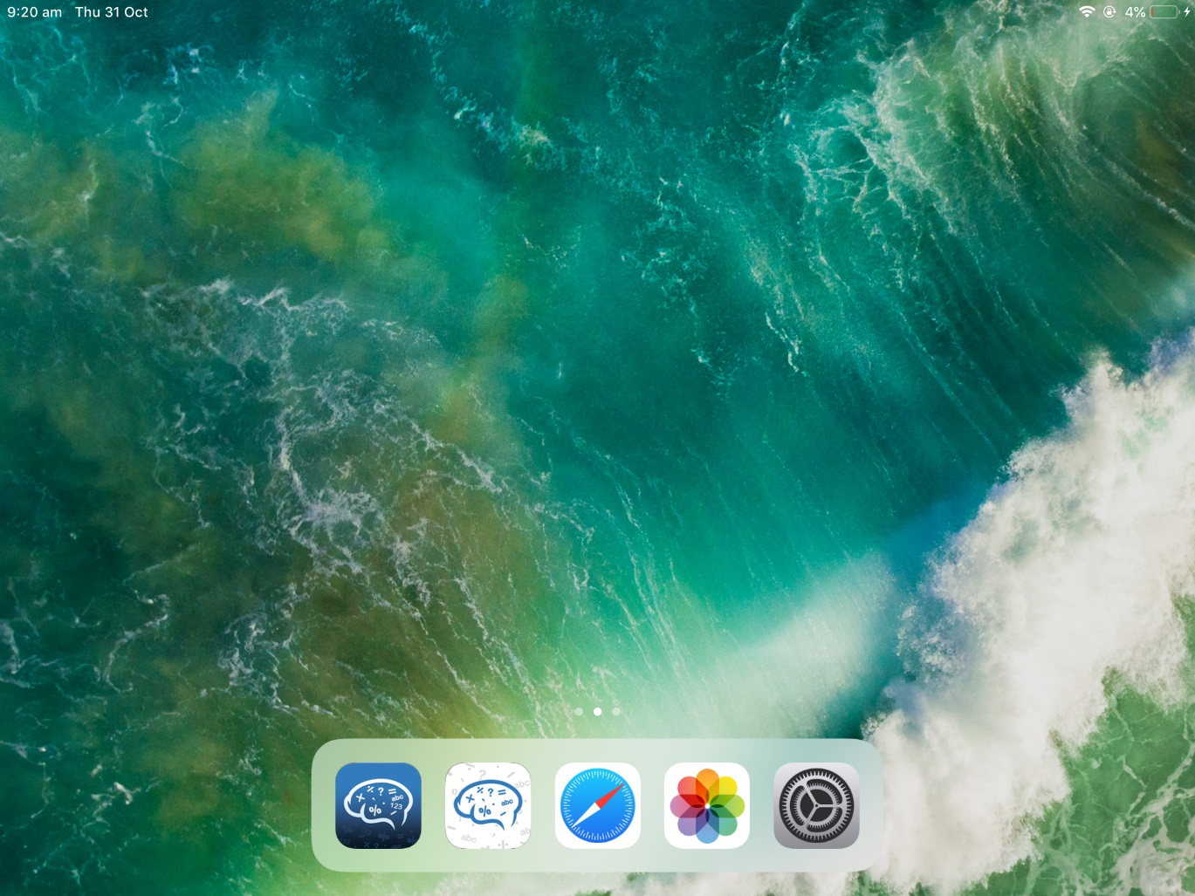
1. iPad introduction
The uEducateUs Kiosk requires an iPad with iOS 7.1 or later and operates in both portrait and landscape mode.
Replay
Prev
Home
Next
uEducateUs – powered By Linked Success

Slide 6
2. iPad features you need to know
Silent
Toggle
Volume
Buttons
iPhone button location.
Home Button
  Pressing this button once will return you to the iPad's Home Screen
  Pressing this button twice in quick succession (within a one second window) will bring up the Open Apps view.
Sleep/Wake Button
  Holding this button while the iPad is on brings up the Slide to power off screen.
  Pressing this button when the iPad is off will turn it on
Silent Toggle
  Depending on your iPad settings, the screen rotation or rotation lock may be assigned to this button. If your screen fails to rotate as expected, you may be required to check the switch location or setting.
Volume Buttons
  Increase and decrease the volume
iPad Camera
Sleep/Wake
Button
Camera
Home
Button
Continue
Replay
Prev
Home
Next
uEducateUs – powered By Linked Success

Slide 8
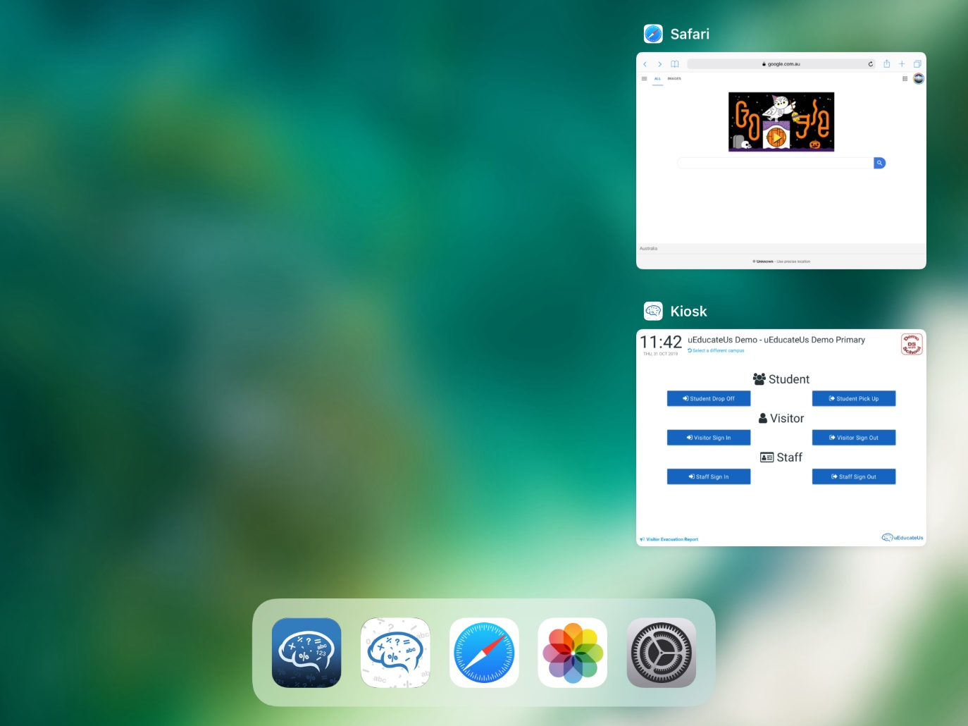
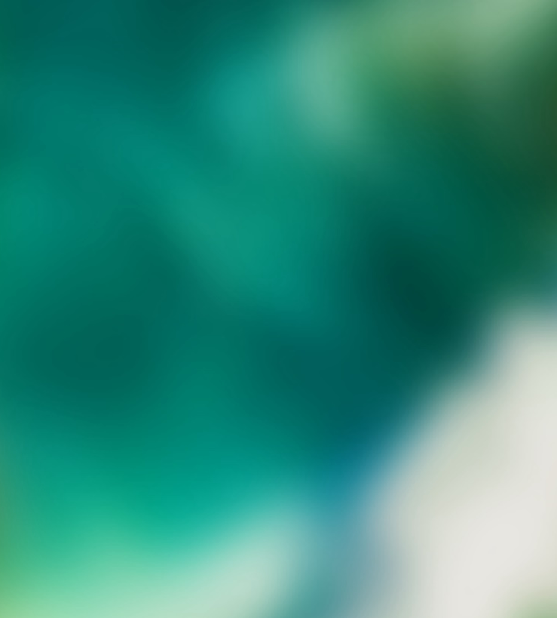
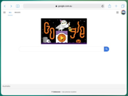


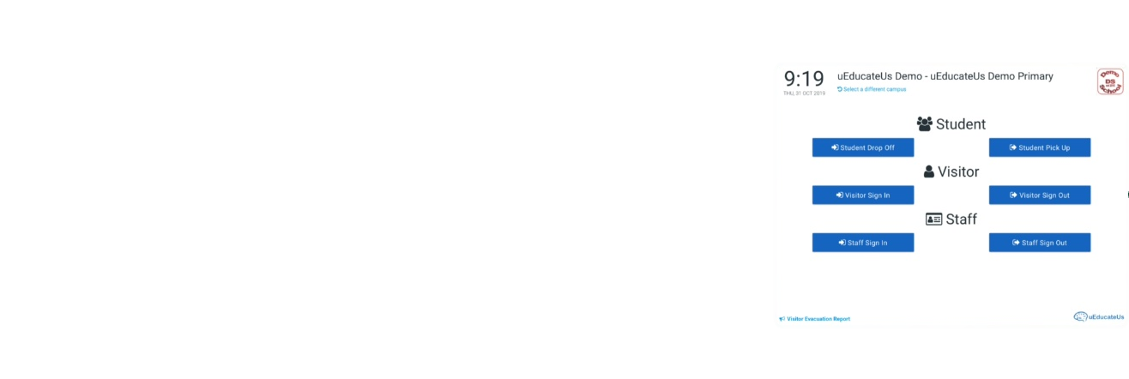
3. Open apps view
When pressing the Home Button twice, the iPad's display changes to show you all the current open apps you have on your iPad.
Taping on an app window will take you to that app.
Flicking up on an app will close the app. This is especially effective if an app has become unresponsive or misbehaving.
Replay
Prev
Home
Next
uEducateUs – powered By Linked Success

Slide 10
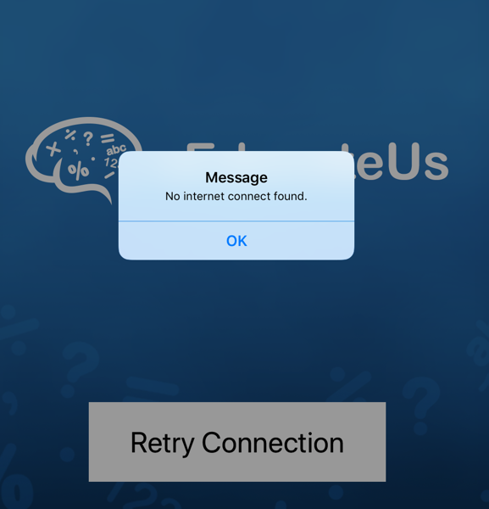
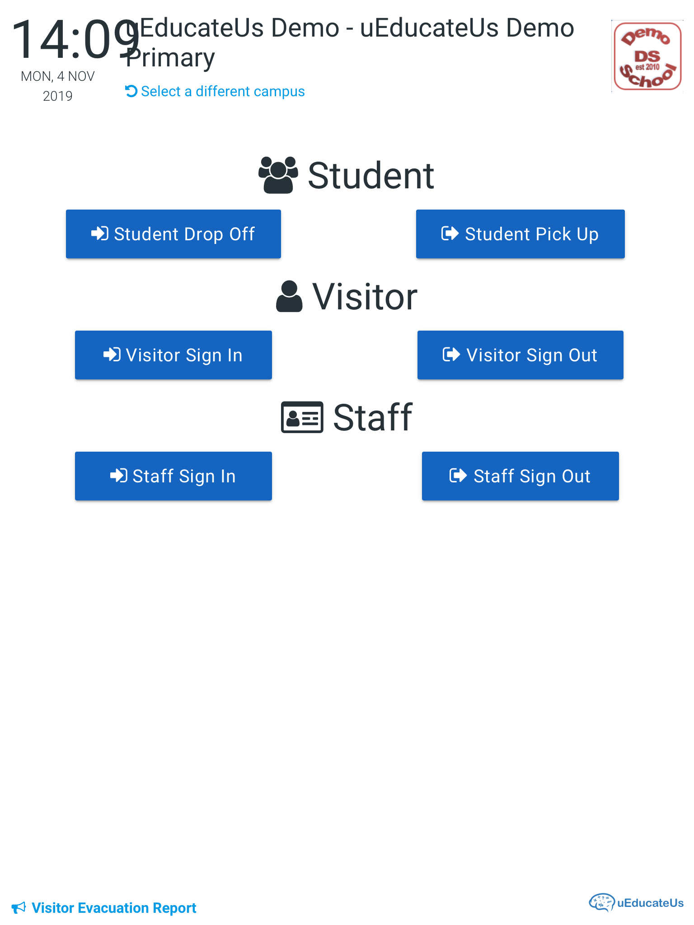


4. No internet connection
There may be an occasion where the No internet connection screen will be displayed.
This screen is a result of the iPad not having an established connection to the internet when an action was taken.
It is possible that the internet connection has been re-established since the last action so to check and attempt to resolve this issue, we begin with tapping the Retry Connection button.
If a connection is found you will be taken to the Kiosk main menu.
If no connection is found then the iPad will provide you with the following error and further troubleshooting is required.
ü
Replay
Prev
Home
Next
uEducateUs – powered By Linked Success

Slide 12
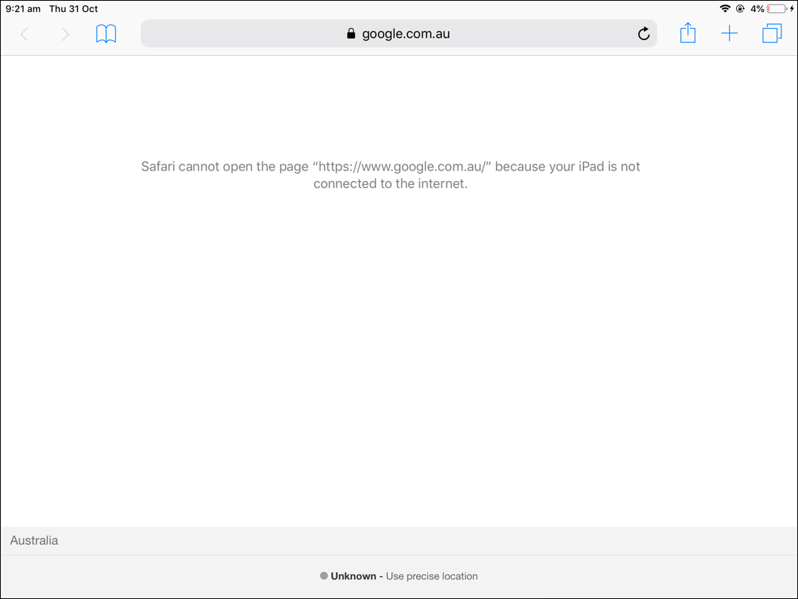
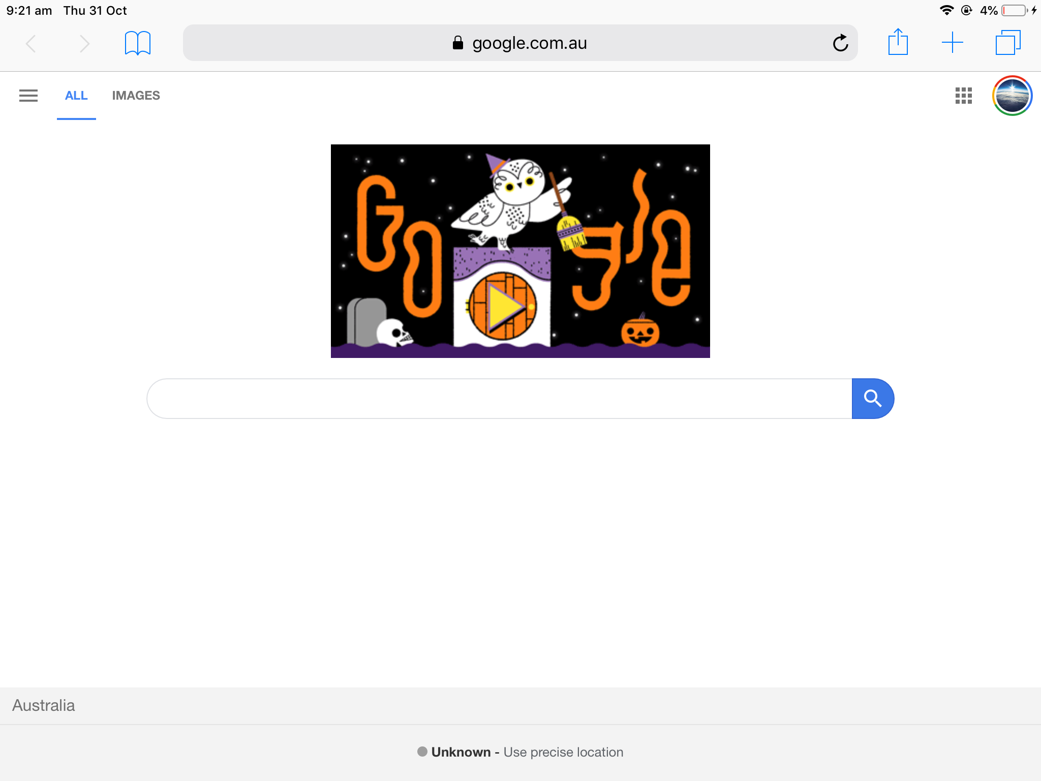
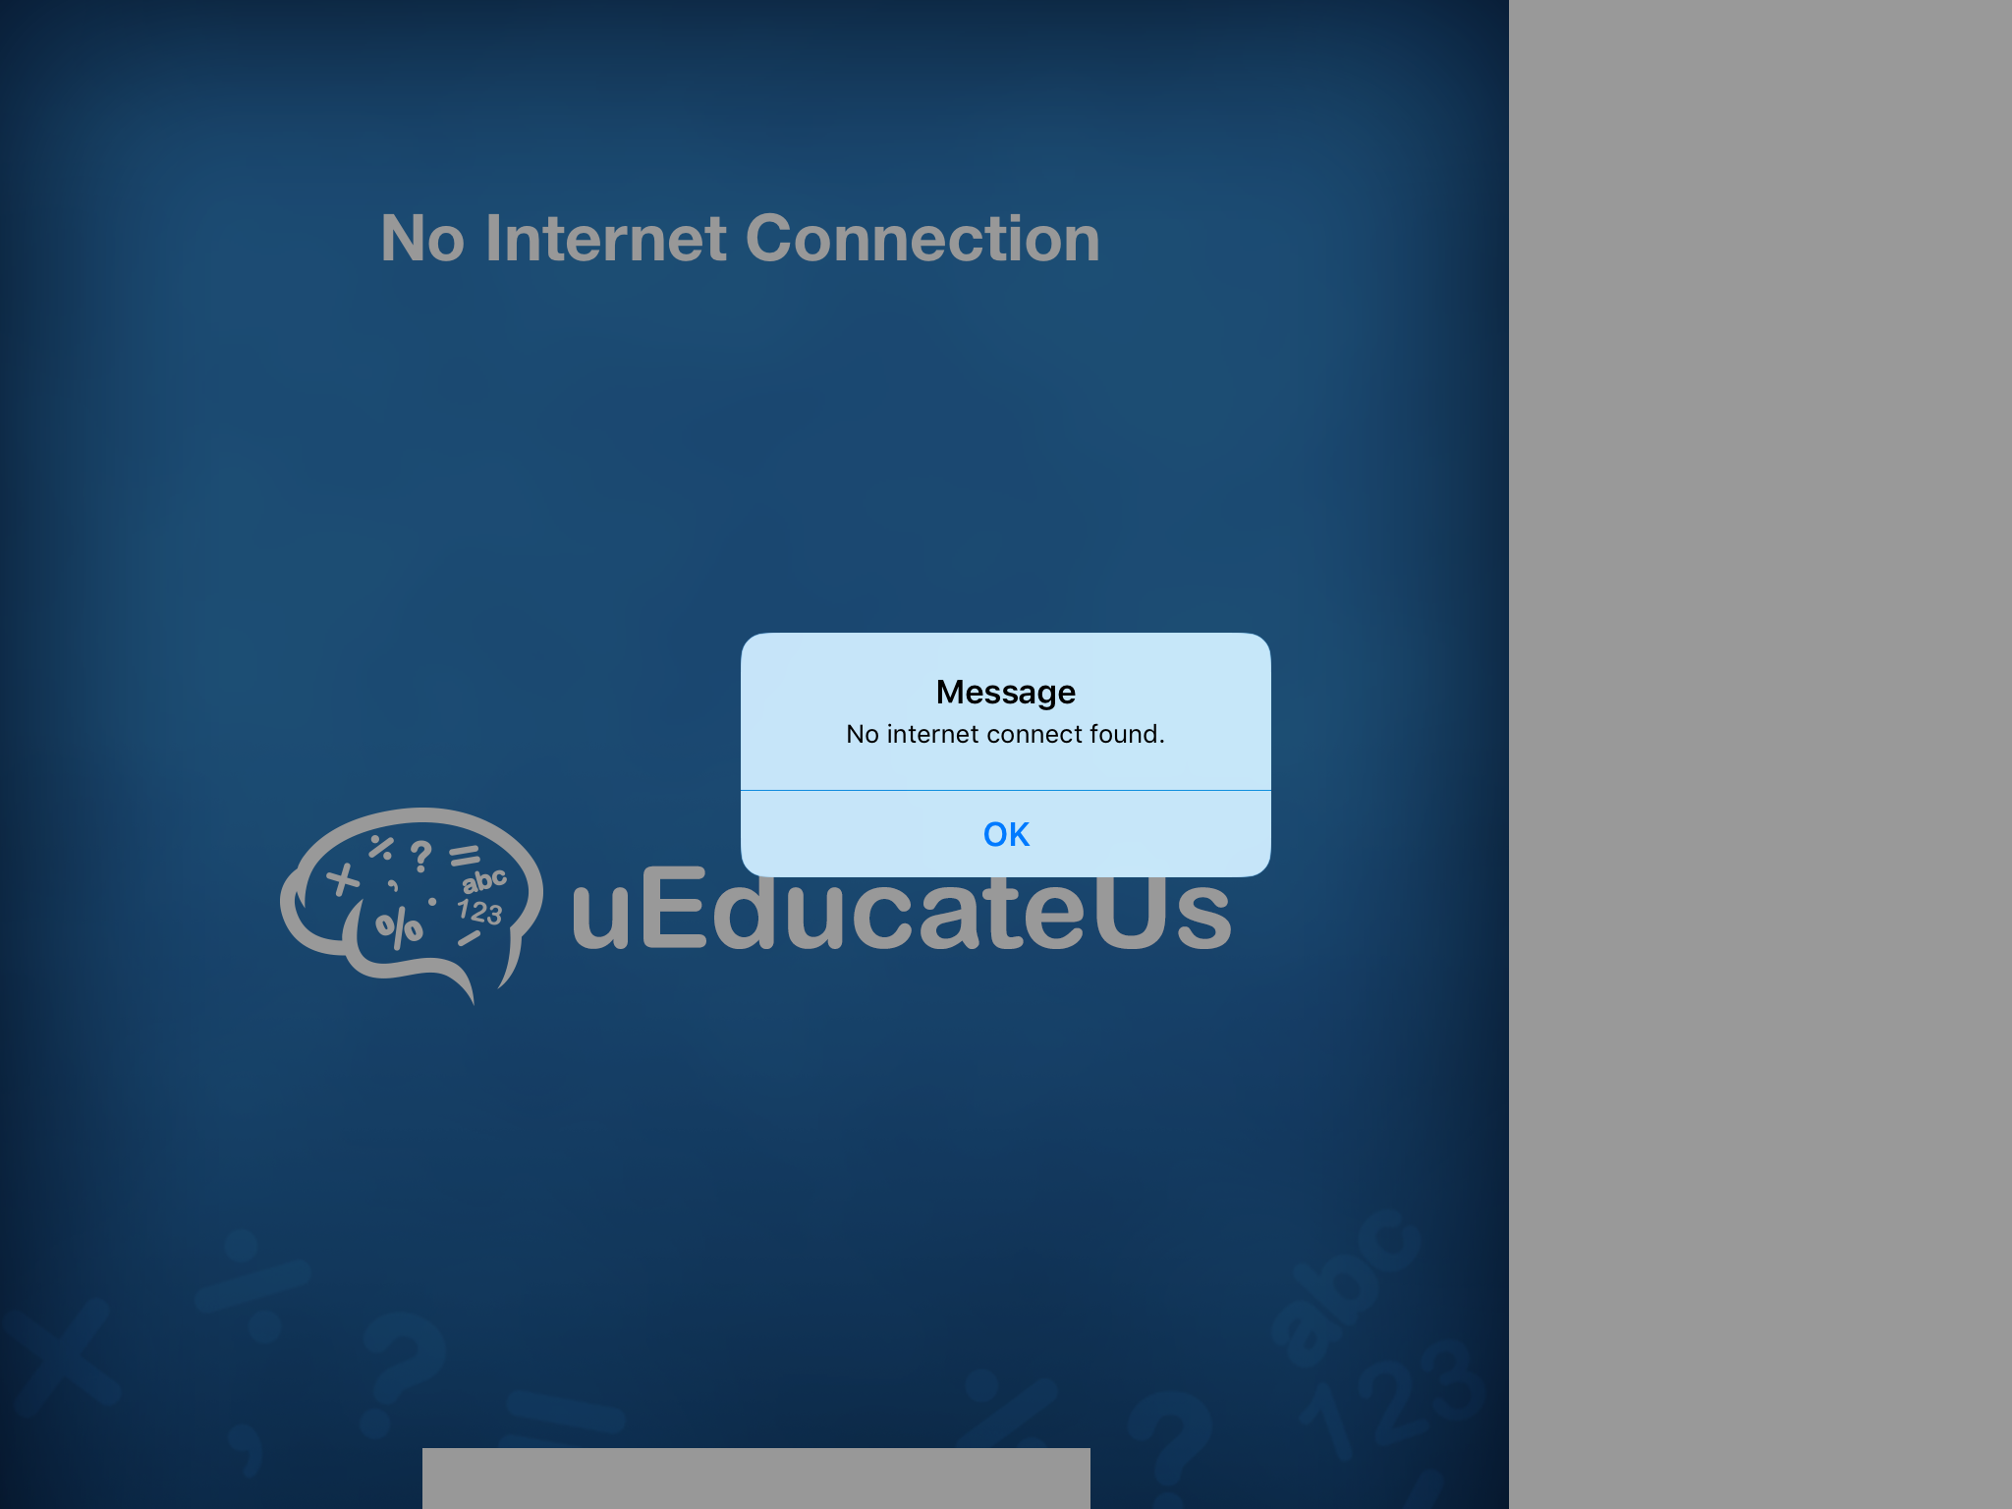
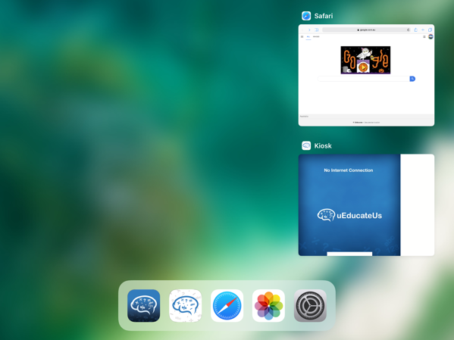
5. Checking Safari app internet connection
Checking another app on your iPad is required to confirm that there is indeed no internet connection.
From the home screen, open the safari app.
If your browser has a home page set, tap the refresh icon. You will get on of two possible outcomes:
The page will not load with the following error Safari cannot open the page…
This confirms that the iPad has no internet connection. You WiFi network may be unavailable or that there is a network issue that will need to be investigated by your IT specialist.
If the web page loads successfully, jump back to the running uEducateUs Kiosk
  Tap OK to clear the message box
  Tap Retry Connection button.
If the Kiosk remains unavailable, you need to restart the app.
ü
Replay
Prev
Home
Next
uEducateUs – powered By Linked Success

Slide 14
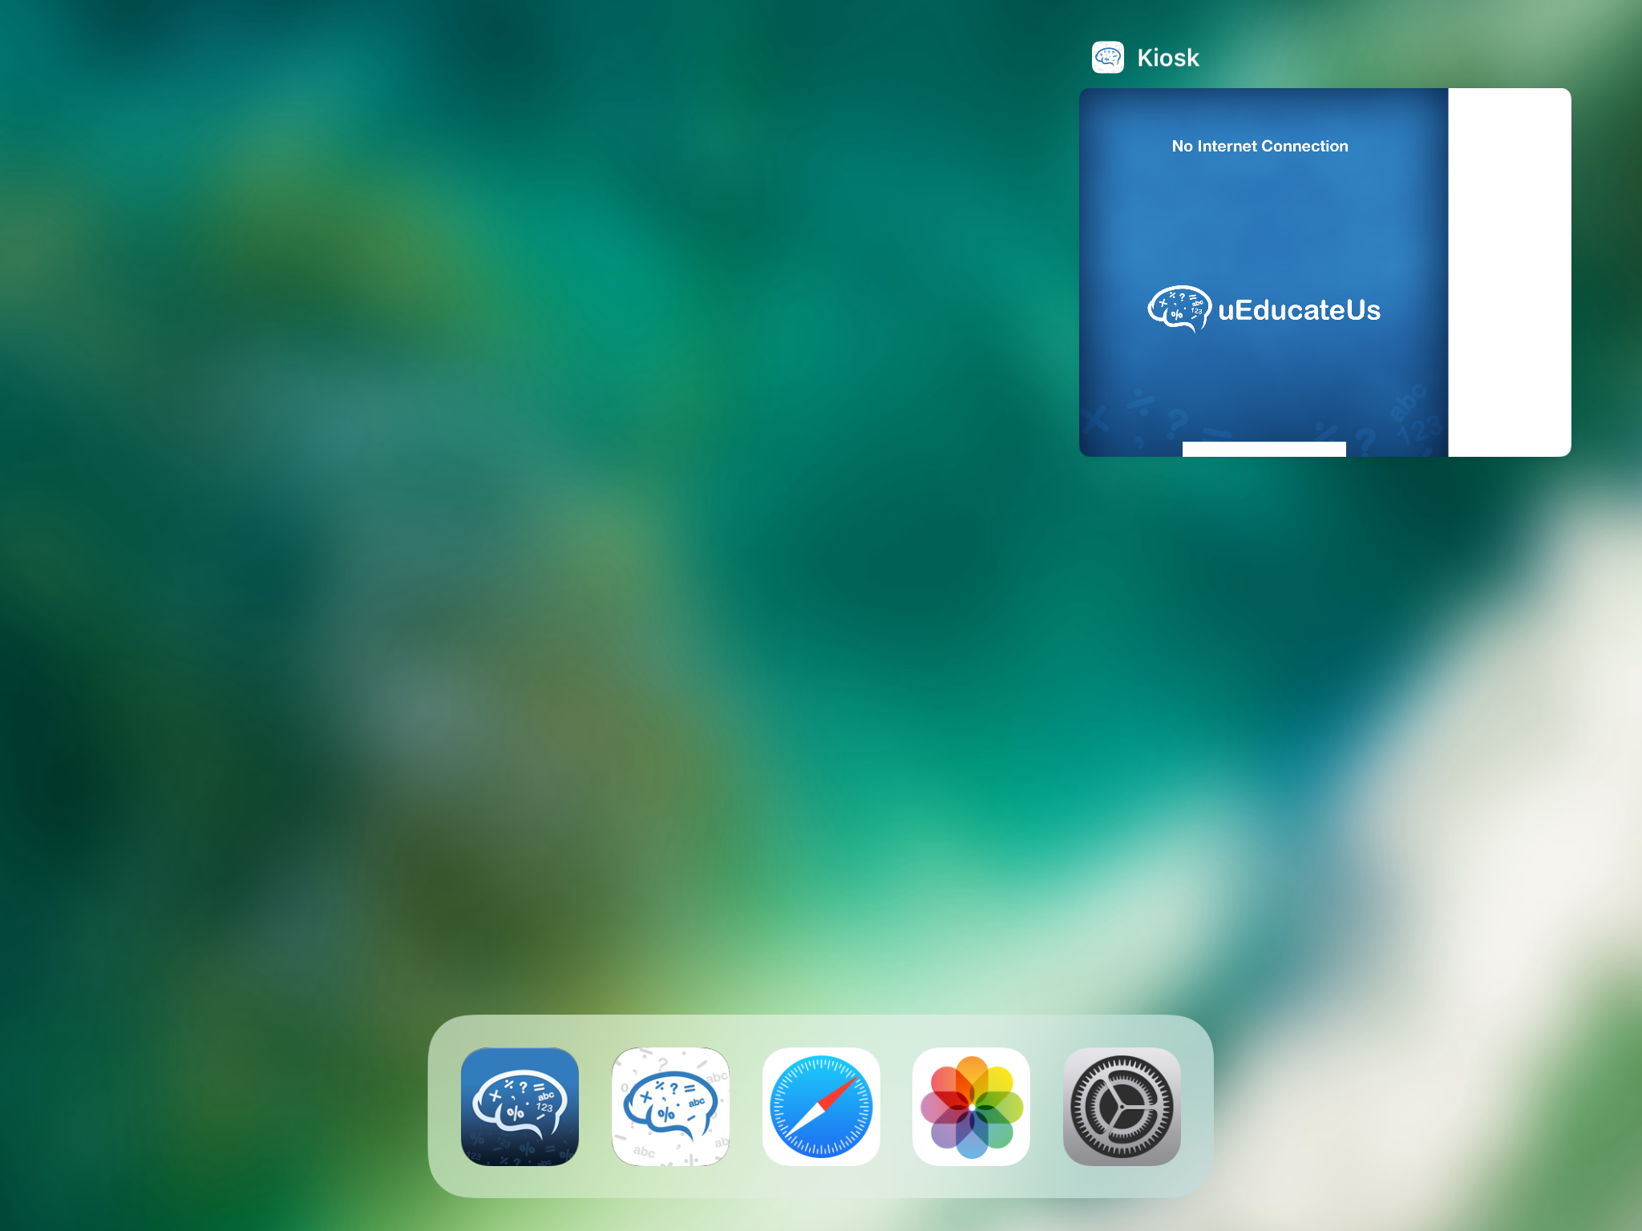

6. Restarting the Kiosk app.
To restart the Kiosk app, simply double press the Home button on the iPad.
This will open the App view screen.
Simply flick up on the visible Kiosk app and it will disappear.
You can now easily open a new instance of the Kiosk by tapping the Kiosk app icon from the shortcut list.
The Kiosk App will go through its start up process and load to the Main menu.
Note: The Kiosk application registers the iPad device id upon its first successful login. Please give the device 5-10 seconds for the iPad to pass its authentication process back to uEducateUs.
It will then automatically login to the main menu.
If the iPad remains on the Login screen after this time, please enter a current uEducateUs Administrator login to be taken to the main menu.
ü
Replay
Prev
Home
Next
uEducateUs – powered By Linked Success

Slide 16
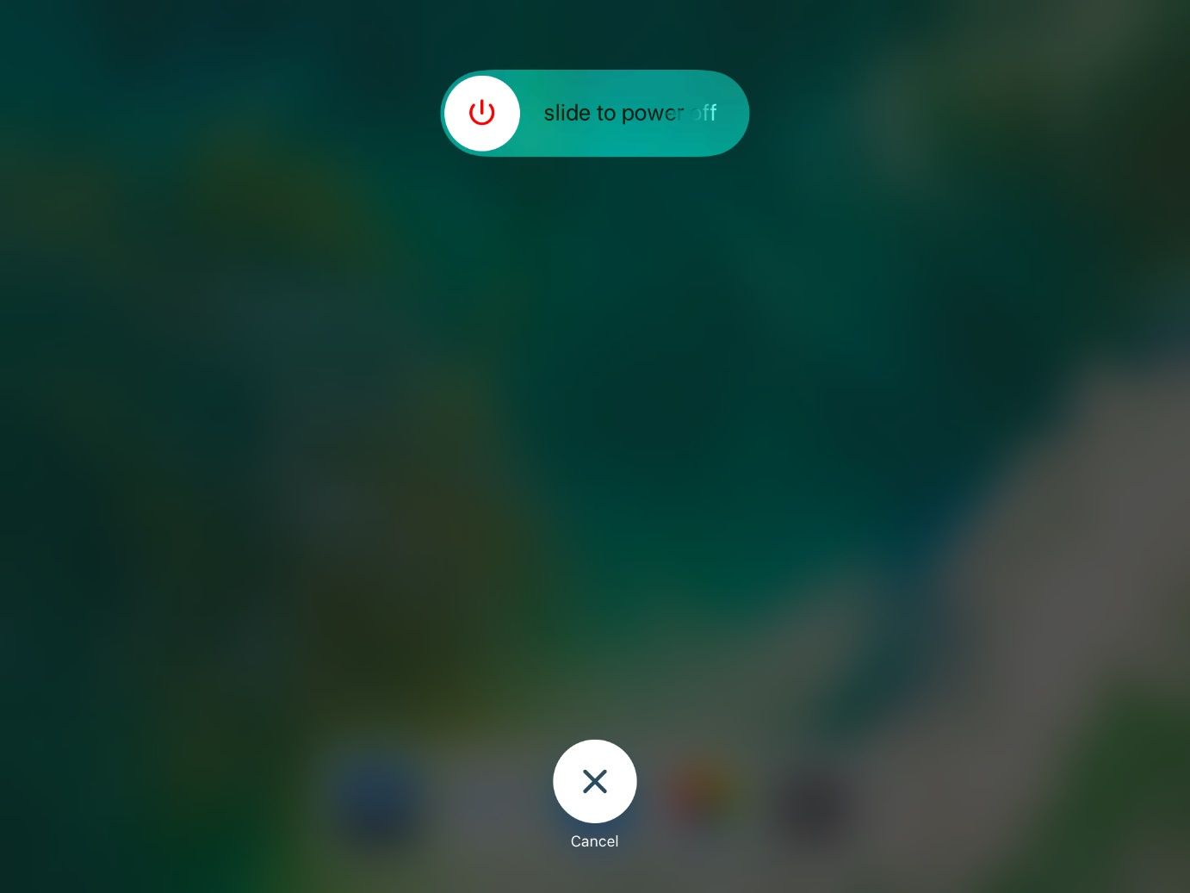
7. Reboot iPad.
To perform a iPad reboot, you will need to hold the Sleep/Wake button for about 4-5 seconds
The iPad display will ask you to slide to power off.
Slide the icon to the right to preform a reboot.
Once powered down, press and hold the Sleep/Wake button again to turn on the device.
Open the Kiosk app and check it is operating as expected.
If at this stage the Kiosk remains inoperable, the final option is to uninstall the Kiosk app and reinstall it.
Sleep/Wake
Button
Replay
Prev
Home
Next
uEducateUs – powered By Linked Success

Slide 18
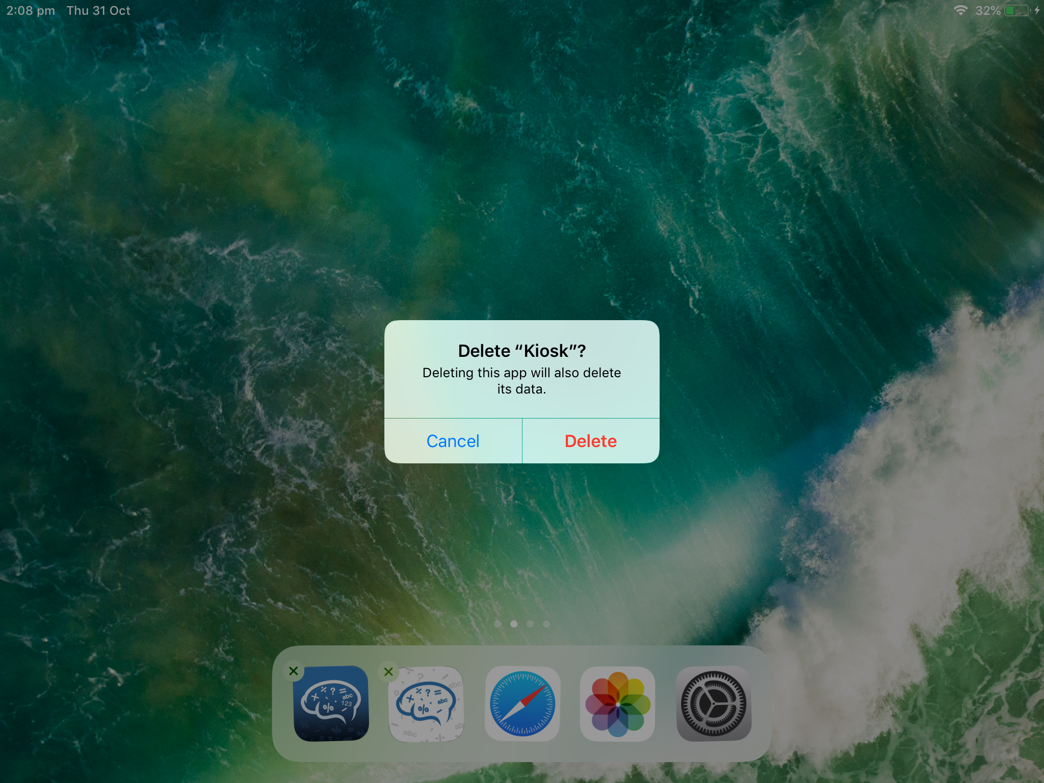
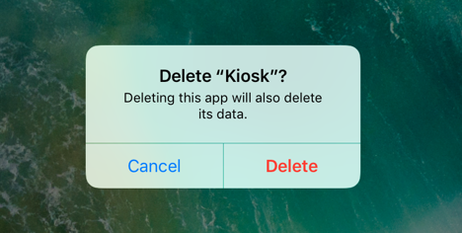
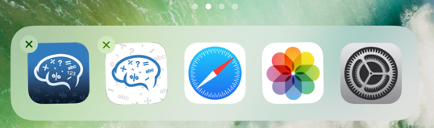
8. Delete and installing the Kiosk app.
To uninstall the Kiosk you need to need to hold your finger on the Kiosk app icon.
After about 2 seconds, the app will begin to wiggle and a small will be displayed in the top left of the icon.
By tapping on X the iPad will provide you with a prompt to confirm you wish to delete the Kiosk app.
Tap Delete to proceed with removing the Kiosk app from the iPad.
A reboot of the iPad is recommended at this stage.
Once complete, open the apple app store by tapping the app store icon and searching for uEducateUs Kiosk application.
Replay
Prev
Home
Next
uEducateUs – powered By Linked Success

Slide 20


9. Contact uEducateUs Support
If you continue to experience with the Kiosk, please contact the uEducateUs support team to conduct further investigation.
It's possible that the iPad has developed an issue, or updates to the iPad may need to be carried out.
1300 833 500
support@ueducateus.com.au
Replay
Prev
Home
Next
uEducateUs – powered By Linked Success

